Slide 1

StreamList App - Incorporating Progressive Web Apps
Pantea Namiranian
The University of Arizona Global Campus
INT499: Capstone for Information Technology (INP2520A)
John Russell
6/15/2025
Notes:
Hello everyone! My name is Pantea Namiranian.
Thank you for joining me today. I’m excited to present the StreamList App, which we’ve developed as a Progressive Web App. This presentation will cover our project's objectives, the technology we used, and the benefits it brings to our organization. Let’s get started.

Slide 2

Project Overview
Objective: Develop a user-friendly platform for managing movie and program lists.
Target Audience: Movie enthusiasts and casual viewers.
Expected Outcomes: Enhanced user engagement, increased retention, and potential revenue growth.
Notes:
The main goal of the StreamList App is to provide an easy-to-use platform for users to manage their movie and program lists. We want to attract both movie lovers and casual viewers to increase user engagement and retention, which can help boost our organization's revenue.

Slide 3
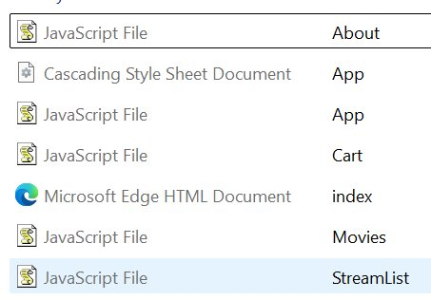

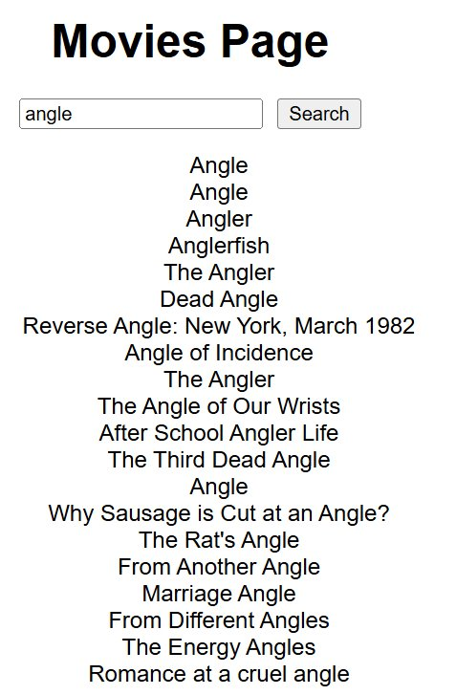
What is a Progressive Web App (PWA)?
A web application that utilizes modern web capabilities to deliver an app-like experience.
Key Features:
Offline access
Installable on devices
Responsive design
Push notifications for user engagement
Notes:
A Progressive Web App, or PWA, combines the best features of web and mobile applications. It provides an app-like experience, including offline access and the ability to be installed on user devices. Additionally, PWAs are responsive, ensuring a seamless experience across various devices. The potential for push notifications further enhances user engagement by keeping users updated with the latest content.

Slide 4
Business Value of PWAs
Improved User Engagement Faster load
times and offline capabilities
Increased Performance
Enhanced speed and reliability
Cost-Effective
Single codebase for web and mobile
Cross-Platform Compatibility
Reaches a wider audience
Notes:
Implementing PWA features offers significant business value. Improved user engagement through faster load times and offline capabilities leads to higher user satisfaction. Moreover, the enhanced performance and reliability of PWAs can reduce bounce rates. Additionally, a single codebase for both web and mobile platforms reduces development costs, allowing us to reach a broader audience more efficiently.

Slide 5
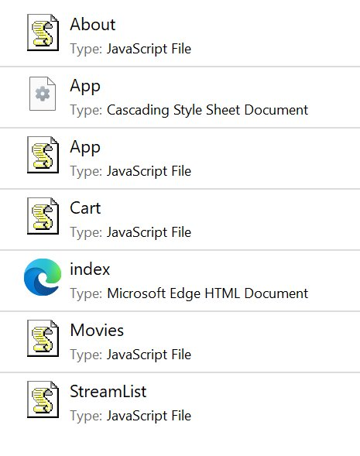
Technical Architecture
Key Components:
Service Worker: Caches assets and manages offline functionality.
Manifest File: Defines app appearance and behavior.
Hash-based Routing: Ensures smooth navigation.
Notes:
Let’s discuss the technical architecture of the StreamList App. The service worker is responsible for caching assets and managing offline functionality, allowing users to access the app without an internet connection. The manifest file provides essential metadata about the app, while hash-based routing ensures smooth navigation without requiring server-side support.

Slide 6
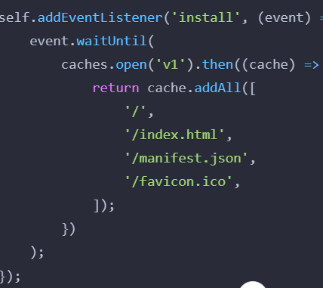
Service Worker Implementation
Purpose
Caching essential files for offline access
Benefits
Improved load times and user experience.
Code Snippet
Notes:
The service worker is a critical component for providing offline capabilities. By caching essential files during installation, we ensure that users can access the app even without an internet connection. This implementation significantly improves load times and enhances the overall user experience. The code snippet illustrates how we set up the service worker to cache key resources.

Slide 7
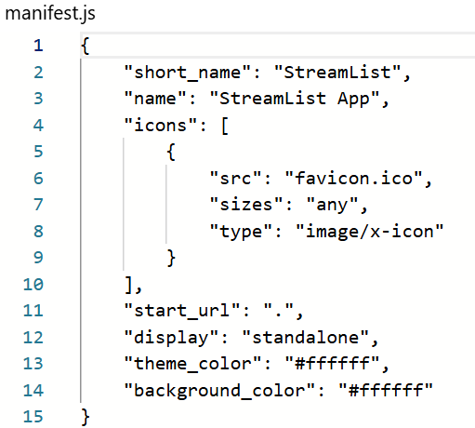
Manifest File Overview
Purpose
Defines how the app appears on user devices.
Key Attributes:
short_name: App's short name for display.
name: Full app name.
icons: Icons for different resolutions.
start_url: Launch URL for the app.
display: App display mode (e.g., standalone).
Notes:
The manifest file is essential for defining how the app appears on user devices. It includes attributes such as the app's name, icons, and launch URL. By providing a consistent experience across devices, we enhance user satisfaction and encourage app installations.

Slide 8
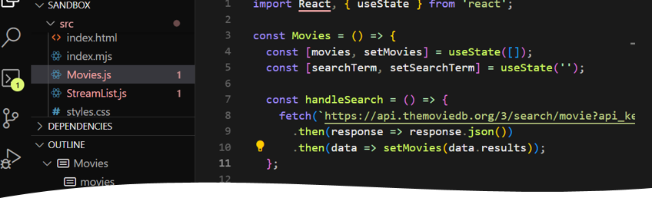
Hash-based Routing Benefits
Explanation of Hash-based Routing: Uses URL hash for navigation.
Advantages: No server-side dependencies, avoids pushState errors.
Example: Navigating to http://localhost/#/movies.
Notes:
We implemented hash-based routing to manage navigation within the app. This approach utilizes the URL hash, allowing the app to function correctly even when opened directly in a browser. This eliminates the need for server-side dependencies and avoids common pushState errors, ensuring a seamless user experience.

Slide 9
Key Features of the App
StreamList:
Add, complete, and delete streams.
Data persistence using local storage.
Movies:
Search for movies using TMDB API.
Dynamic display of search results.
Cart:
Placeholder for future cart functionality.
About Page:
Information about the app and its purpose.
Notes:
The StreamList App includes several key features. Users can add, complete, and delete streams with data persisted in local storage for a seamless experience. The Movies page allows users to search for movies using the TMDB API, displaying results dynamically. We have also included a Cart page as a placeholder for future enhancements and an About page to provide information about the app.

Slide 10
Challenges and Solutions
Key Challenges:
Implementing service workers effectively.
Managing state with local storage.
Ensuring cross-browser compatibility.
Solutions:
Extensive testing and debugging.
Utilizing libraries for state management.
Notes:
Throughout the development process, we encountered several challenges, such as effectively implementing service workers and managing application state with local storage. To overcome these issues, we conducted extensive testing and debugging, ensuring a robust application. We also utilized libraries to streamline state management, which contributed to a more efficient development process.

Slide 11
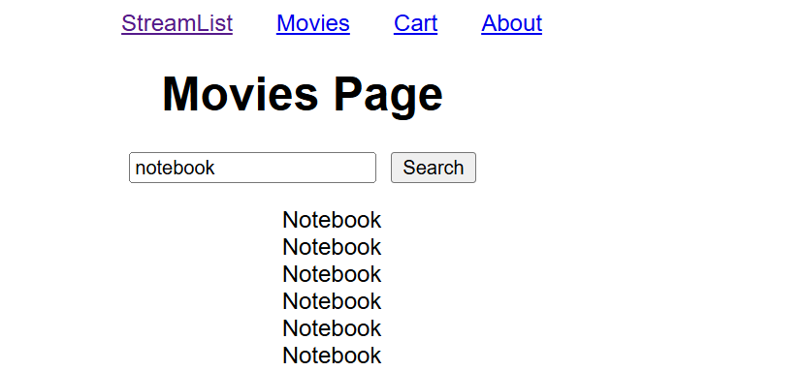
Conclusion and Next Steps
Summary of Key Points
User-friendly interface and PWA features.
Business value through enhanced user engagement.
Future scalability and enhancements.
Next Steps
Gather user feedback for improvements.
Explore additional features based on user needs.
Notes:
In conclusion, the StreamList App effectively incorporates PWA features to enhance user experience and engagement. The user-friendly interface and offline capabilities provide significant business value. As we move forward, the next steps involve gathering user feedback to identify areas for improvement and exploring additional features based on user needs."

Slide 12

Q&A Session
GitiHub Link:
https://github.com/panteanam/Pantea-Namiranian-INT499-Final-Project-Part-1
Notes:
Thank you for your attention! I appreciate your time and would be happy to answer any questions you may have regarding the StreamList App or the PWA features we implemented. Your insights and feedback are invaluable as we look to finalize this project.

